Slide 1

Piano Touch
AhmedKhawaga 141157

Slide 2
PROBLEM
The main problem is that learning Piano is taking too much time.

Slide 3
Why?
Artificial intelligence can teach people how to play piano in 30 min !
Gloves could be easier to use and modify depending on the needs of the user.

Slide 4
Work Methodolgy

Slide 5
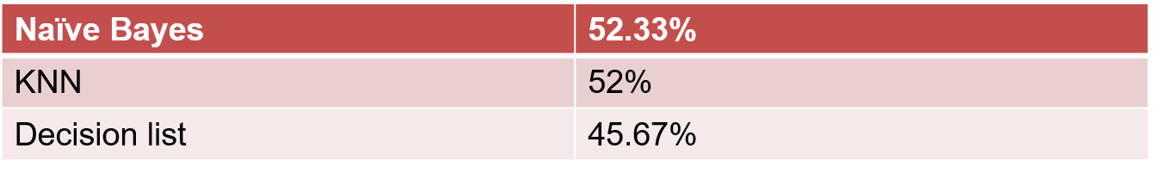
Related work
Title: Mobile Music Touch
Algorithms: Naïve Bayes, KNN and decision list
Accuracy:

Slide 6
Related work
Title: Vibrating musical glove
Algorithm: genetic algorithm
Accuracy : 67.14%

Slide 7
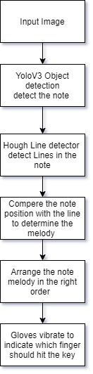
Flow of Control

Slide 8
How YOLO work ?
YOLO is a single-stage detector therefore it unifies all the components of object detection into the single neural network.
YOLO divides the whole image into the S x S grids.
Grids will be predicting B boundary boxes. If the center of an object falls into a Grid cell then that cell will be responsible for detecting that particular object.
The bounding box prediction has 5 components: (x, y, w, h, confidence).
Notes:
It process on all the cells simultaneously, which gives it faster-processing speed

Slide 9
Intersection over Union (IoU)
In Yolo object detection, to find out how well our boundary box is capturing the object we use the IoU ratio.

Slide 10
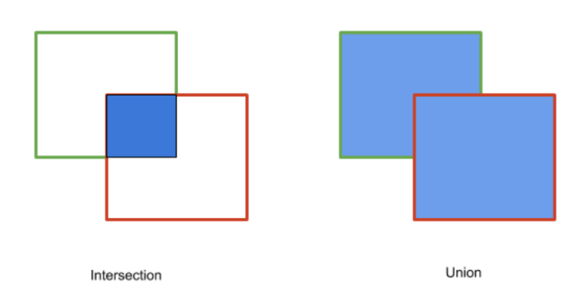
Intersection over Union (IoU) Equation.
IoU = Area of intersection / Area of Union

Slide 11
Confidence Score.
Yolo model calculates the confidence score for each boundary box associated with a cell. This confidence score tells how confident the model is about capturing the object and how accurately (closest to the object) captured by a given boundary box

Slide 12
Confidence Score Equation.
Confidence Score = Pr(Object) * IoU
Notes:
If there is no object present in the predicted boundary box then the confidence score should be 0, otherwise, it should be equal to IoU

Slide 13
evaluating YOLO.
Y=S x S x (B * 5 + C).
The main task of the YOLO network is to create this tensor Y for the given image.

Slide 14
evaluating YOLO.
Next Yolo take the feature map from 2 layer pervious and up sample it by 2×. Yolo also take a feature map from earlier in the network and merge it with up sampled features using concatenation.
Then add a few more convolutional layers to process this combined feature map, and eventually predict a similar tensor (Y), although now twice the size.
Perform the same design one more time to predict boxes for the final scale.

Slide 15
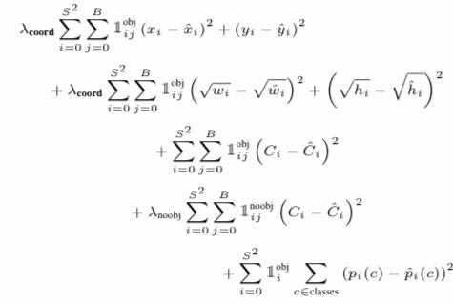
YoLO V3 Lose function equation.
Classification Loss: It the sum of squared error between the class probabilities of predicted class and actual class. It is the sum of the classification losses of each cell.
Localization Loss: It is the sum of squared error between the coordinates, height, and width of predicted and actual boxes.
Confidence Loss.
Notes:
Ĉ is the intersection over union of the predicted bounding box with the ground truth(back prograthion)

Slide 16
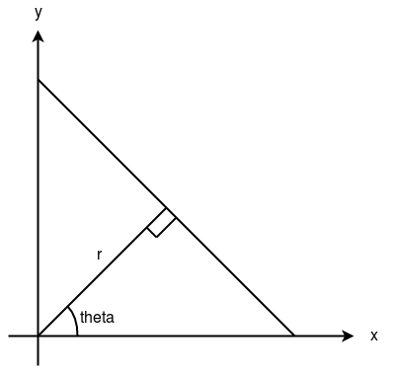
Basics of Hough line Method
A line can be represented as y = mx + c or in parametric form, as r = xcosθ + ysinθ where r is the perpendicular distance from origin to the line, and θ is the angle formed by this perpendicular line and horizontal axis measured in counter-clockwise ( That direction varies on how you represent the coordinate system. This representation is used in OpenCV).
So Any line can be represented in these two terms, (r, θ).

Slide 17
How Hough Line Work
First it creates a 2D array or accumulator (to hold values of two parameters) and it is set to zero initially.
Let rows denote the r and columns denote the (θ)theta.
Size of array depends on the accuracy I need. In my case I want the accuracy of angles to be 1 degree, So I need 180 columns
For r, the maximum distance possible is the diagonal length of the image. So taking one pixel accuracy, number of rows can be diagonal length of the image.

Slide 18
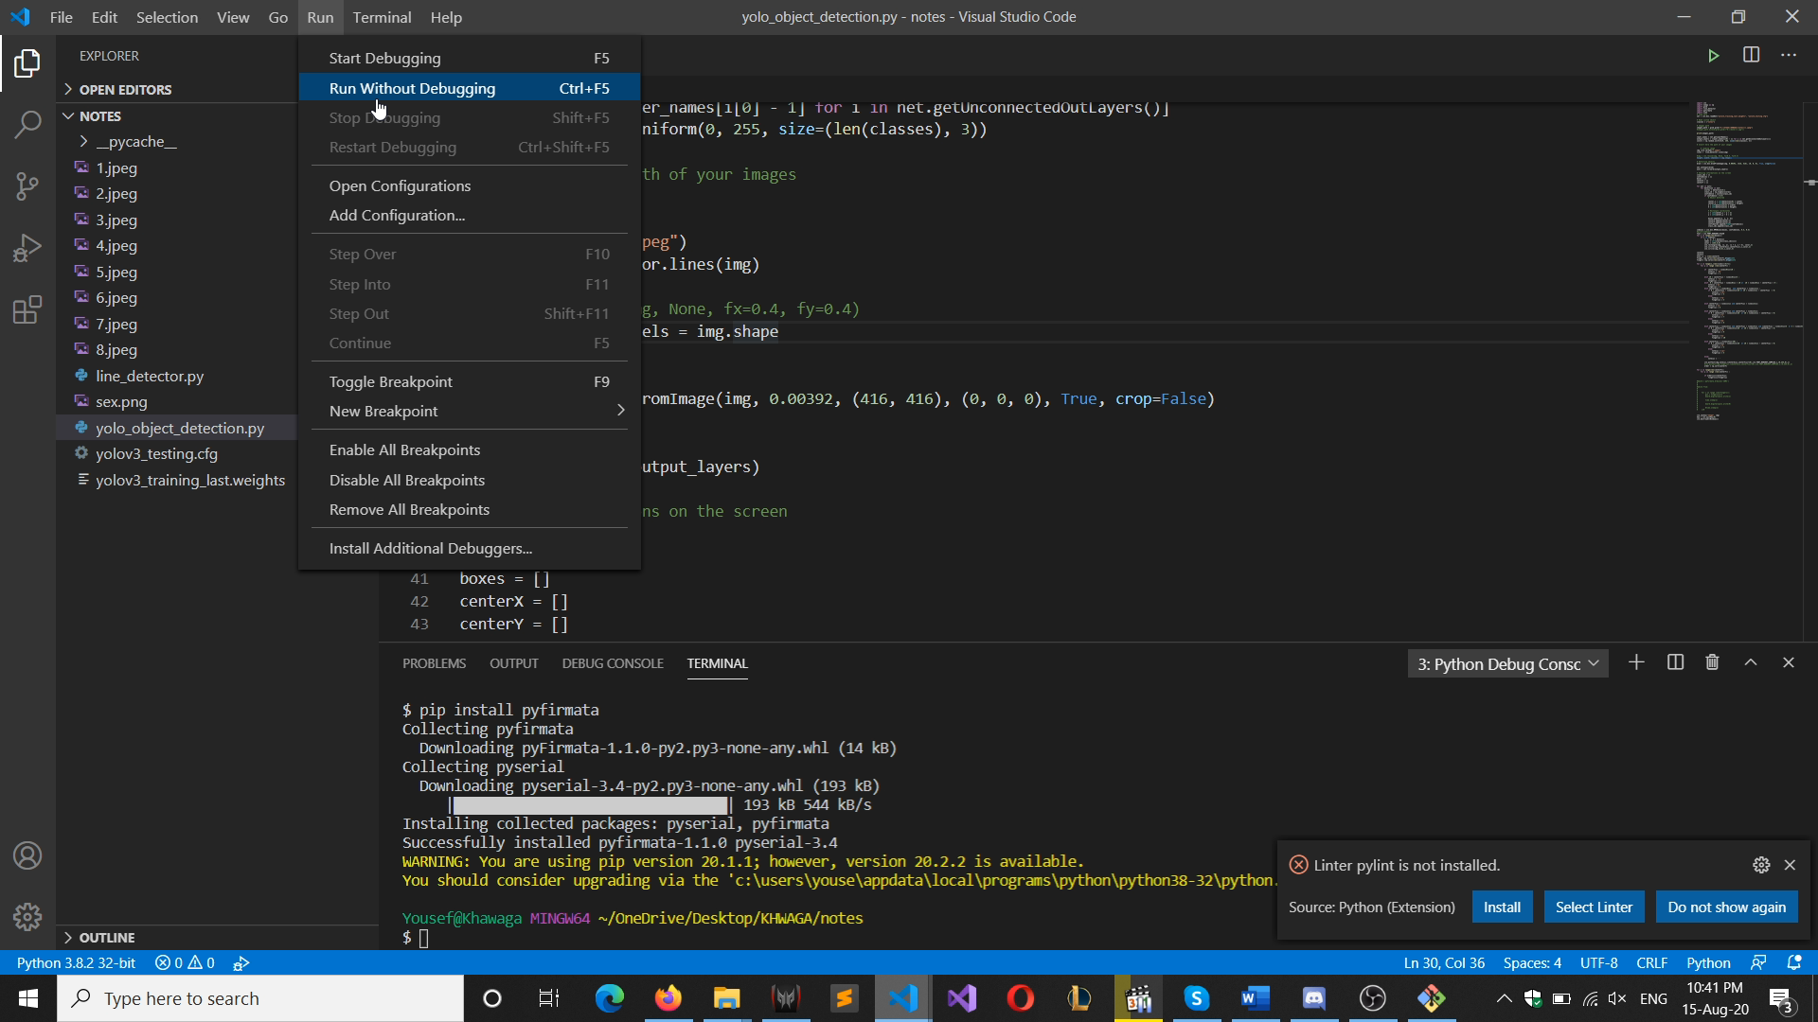

Slide 19
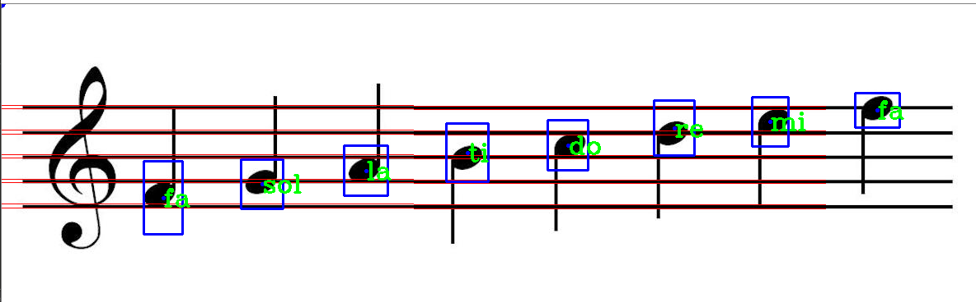
Sample From run

Slide 20
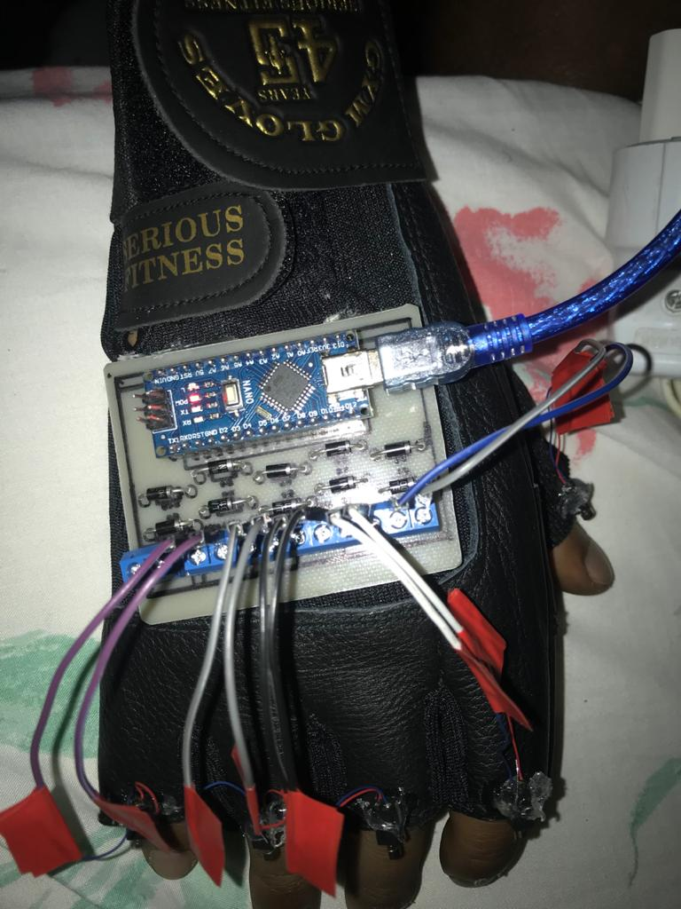
Functional Requirement Of the gloves
1.Run the note on the gloves motor through vibration.
2. Active the cross-ponding motor to the finger depending on the coming signal.
3.The motors on the gloves should only run when It have the signal.
4.The gloves should not miss any coming signal and detect all moldy on the note.
5. The gloves should stop vibrating after certain time.

Slide 21
Components Used in the gloves
1-Vibrating DC-motors
2-Printed circuit board
3-Diodes
4-Arduino Nano
5-Gloves

Slide 22
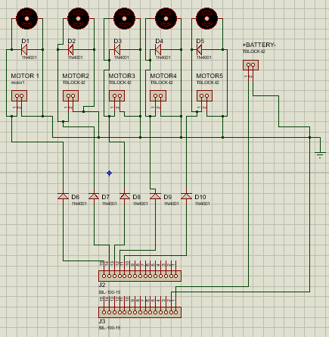
Circuit design
It is required to enable 5-Motors using Arduino nano, as the operating current of the motors is too low(4uA/empirical data)(suitable for Arduino nano),I decided to take the signal out from the Arduino to directly enable the motors.

Slide 23
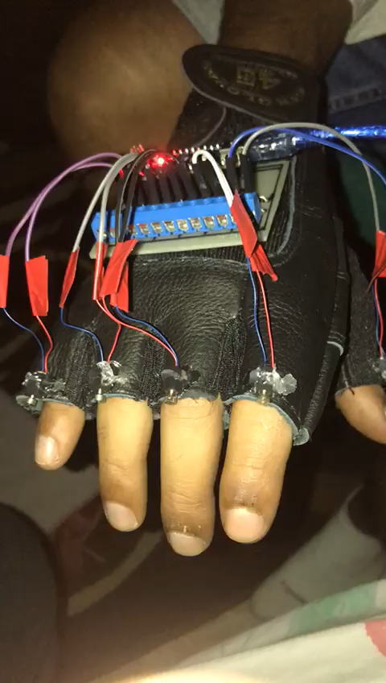
Gloves in the work

Slide 24

Future work
In the future, we will create a mobile application that will be responsible to upload an audio or image note on the gloves and control the number of repeating notes. In addition, the gloves will be manufacture with high-quality and will be over-qualified. We will reduce its size and makes its special design.

Slide 25

Thank you

